Slide 1
Defining a Legacy
Defining a Legacy
Team 4
Maxwell Grbic | Deborah Page | Natalie Shi | Nina Updike

Slide 2

Imagine
the
world of
2084

Slide 3

Our Research
Our Research
Primary
Interviews with deputy coroner, psychology major, loved ones of suicide victims
Secondary
News and research articles
Video lectures

Slide 4
Our Findings
Our Findings
Closure vs. comfort
Different deaths lead to different grieving processes
Suicide victims' loved ones often experience guilt and a feeling of powerlessness

Slide 5

Our Audience
Our Audience
Loved ones of victims of suicide

Slide 6
The Problem
The Problem
How can we empower the loved ones of people who commit suicide using the deceased's digital assets?

Slide 7
Insights
Insights
What if we could turn a complete tragedy into one with a glimmer of hope?
What if that method could respond proactively to others' suicidal ideation?

Slide 8
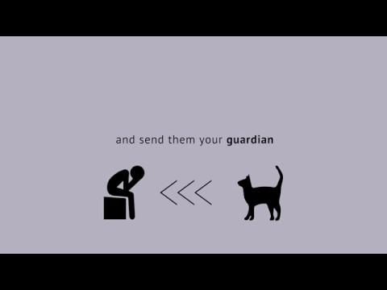

Slide 9
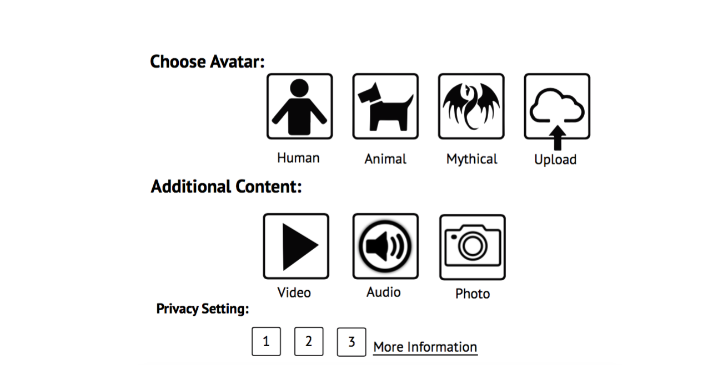
The Interface
The Interface

Slide 10
Outline of Conversation
Outline of Conversation
Inform person that conversation is confidential
What the guardian is
Who they are here on behalf of
Ask for permission to share some things
Assess proper steps forward
Ask if follow-up is wanted/needed

Slide 11
Ethical Considerations
Ethical Considerations
Anonymity
Suicide victims'
Person being visited
Legal
Service enacted by next of kin
Wouldn't replace last will
Deontological
Duty to society
Duty to the individual
Utilitarian
What causes the most happiness?
What causes the least pain?

Slide 12
Our Design Is
Is Not
Our Design Is
Is Not
Action
Private
Suicide prevention aid
To help others
Proactive
A way to cling to the past
An alarm system
Profiting on grief
To bring closure
A call service

Slide 13
Thank you for listening
Thank you for listening
Questions?

Slide 14
Appendix

Slide 15
Example Interaction with Guardian
Guardian: "Hi 'name', I am a Guardian. Anything you say to me will remain completely confidential, to allow full expression of your feelings."
Guardian: "I am here because it seems like you're going through a lot right now, and there are people out there who care. I hope to show you things that others have missed out on when someone they loved committed suicide. People submit their loved ones' data and information to allow me to intervene when someone is feeling down or upset. I am here to show you things that may help you value your life and connections with others. Maybe seeing this will help you feel a bit better."
Guardian: "On behalf of 'name' I am here to provide you with the opportunity to interact with me. From this we will both be able to converse, and I will show you things that proves that victims of suicide belonged, and had importance in their social circle."
User: "Yes (or No), I would like to interact with this system."
~Interaction with Guardian~
Guardian: “Would you like me to follow-up in the future?”

Slide 16
Usability Tests
First Test
Chelsea thought that the video was engaging throughout, but initially confusing. When asked to describe the idea after watching the video she was able to accurately summarize it.
"I'm the kind of person who wants to do something. Here's something you can do for someone else."
She thought that clarifying guardian interactions and including a trigger warning would be good ideas.
Second Test
When asked about video pacing, Amanda said, "It seems like the correct speed. You're moving it forward and you're just telling the story."
The technology didn't seem like a stretch.
She was able to accurately describe the idea after watching the video.

Slide 17
Existing Assets
https://www.digitaldeath.com/
Inventory your assets and accounts in one comprehensive and organized list.
Grant third-parties (your family, spouse, friends) authorization to those assets and accounts.
Tell your family members that they will be responsible for these assets in the event of your death.
http://www.qeepr.com/
Create a free memorial by adding some basic information
Add unlimited photos, videos, and life history
Send and receive condolence messages
Share with the world or keep it private
https://cemetery.org/
With its simplicity, it has remained the most elegant, peaceful, and serene resting place online.
Memorials are permanent and provide the sole internet presence for many.
One-time fee of $90

Slide 18
Video Lectures
https://www.youtube.com/watch?v=7CIq4mtiamY
"The bridge between suicide and life", Kevin Briggs, May 14, 2014
https://www.youtube.com/watch?v=D1QoyTmeAYw
"Why we choose suicide", Mark Henick, Oct 1, 2013
https://www.youtube.com/watch?v=Mo_mgcxGYYE
"I witnessed a suicide", Joseph Keogh, June 9, 2017
https://www.youtube.com/watch?v=SVe4lAUyY8M
"Suicide: How my failed attempts became my biggest success", Shraddha Shankar, May 25, 2016
https://www.youtube.com/watch?v=Q3WDw-DBKLA
"We need to talk about male suicide", Steph Slack, Aug 28,2018

Slide 19
Articles
http://www.suicidefindinghope.com/content/what_are_the_emotions_of_suicide_grief
Article discusses loved one thoughts and emotions after losing someone to suicide. Goes into detail about different common emotions and tries to make sense of the why’s of these feelings.
First sentence under Guilt: “It’s very common for survivors to feel guilty after a suicide death, where people wonder what else they could have done, or what could have made the outcome different.”
https://ideas.ted.com/11-fascinating-funeral-traditions-from-around-the-globe/
Article describes different social rituals revolving around death and funeral.
New Orleans Jazz funeral:
Funerals that strike a balance of joy and grief. Where a marching band plays sorrowful tunes prior to the burial. But afterwards, plays an upbeat note.
https://childmind.org/article/is-social-media-use-causing-depression/
Article discusses the increasing rates of depression in young adults.

